Slide 1
A11Y aria usage Angular 8
Aria-pressed for tabs

Slide 2
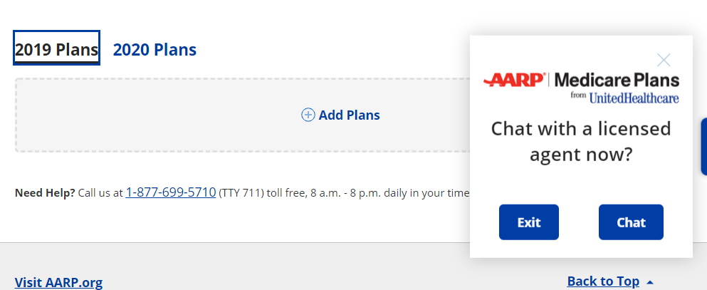
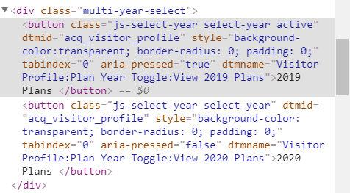
Aria-pressed for tabs
Example: Visitor profile- year plans
Keys – using tab key for the both and using space/enter for selection
Native html - aria-pressed=“true/false”
Angular 8 - [attr.aria-pressed]="appData.activeYear === currentYear"

Slide 3
Aria-pressed for tabs
<div class="multi-year-select" *ngIf="isAEPPeriod()">
<button [attr.aria-pressed]="appData.activeYear === currentYear" [attr.dtmname]="'Visitor Profile:Plan Year Toggle:View ' + currentYear + ' Plans'" class="js-select-year select-year" [class.active]="appData.activeYear === currentYear" (click)="getPlanYearData(currentYear)">{{profilePage.currentyearTab}}</button>
<button [attr.aria-pressed]="appData.activeYear === (currentYear+1)" [attr.dtmname]="'Visitor Profile:Plan Year Toggle:View ' + (currentYear+1)+ ' Plans'" class="js-select-year select-year" [class.active]="appData.activeYear === (currentYear+1)" (click)="getPlanYearData(currentYear+1)">{{profilePage.nextyearTab}}</button>
</div>
Source: https://angular.io/guide/accessibility

Slide 4
Thank you

